Slide 1
Health Policy
Project Argonaut and FHIR
Health Tech Net Interoperability Panel June 19, 2015

Slide 2
A Brief History of FHIR and Project Argonaut
Realizing the Potential of FHIR
FHIR Demonstrations

Slide 3
HL7 FHIR and Project Argonaut
A Brief History of Project Argonaut
April 2004 – Executive Order calling for every American to have an electronic health record by 2014
November 2013 - JASON Report criticizes status and trajectory of healthcare interoperability citing lack of standardized APIs and EHR vendor technology and business practices as major impediments
October 2014 – JASON Task Force recommends adoption of a standard API in MU3 to address
December 2014 – Argonaut Project established to accelerate HL7 FHIR adoption
FHIR – HL7 standard that defines a set of 99+ health care resources and an extensible web services API framework (XML or JSON) for health care information interoperability and application development using modern web standards and lessons learned from prior HL7 work
Characteristics and Benefits
A uniform set of open, published standards that allows authorized access to health-related data
More constrained and modular than previous HL7 versions. Defined technical approach and process for extensibility to handle situations where base standard needs to be enhanced.
Supports both a push and pull of discrete data elements and documents
Project Argonaut – Industry-led initiative to accelerate the market availability of interoperability capabilities based on Fast Healthcare Interoperability Resources (FHIR®) and OAuth2 security, focusing on the 16 resources to expose the MU data set to authorized applications.
Accomplishments
Over 30 organizations have joined the Argonaut Project to conduct testing and implementation activities, refine specifications, and move FHIR towards ANSI accredited normative standard

Slide 4
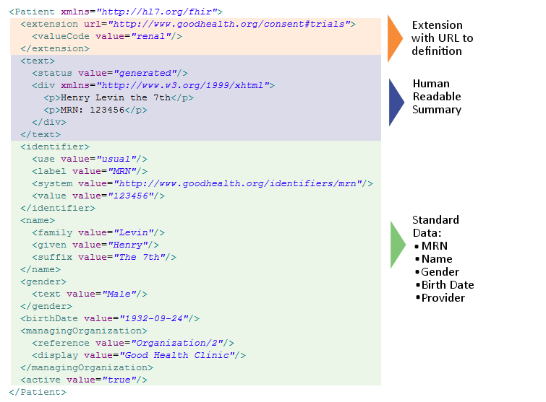
FHIR Resource Example
Notes:
Talk track for 14

Slide 5
Project Argonaut Accomplishments and Next Steps
Phase 1: Develop FHIR community, show viability, build momentum for industry support (June 2015)
Refine FHIR specification and Implementation Guide for data-level transactions on the Common Meaningful Use Data Set
Refine FHIR specification and Implementation Guide for CCDA-level transactions
Develop OAuth security specification and Implementation Guide for within-enterprise delegated access for provider- and patient-facing hosted and mobile applications
Phase 2: Mature the FHIR specification, expand use cases, and increase adoption (December 2015)
FHIR Development -- continue with FHIR development work focused on Argonaut Implementation Guide scope to iterate on quality of specifications and develop constraints on resources, profiles, and queries to accommodate market realities
Security Development -- extend specification and Implementation Guide to cross-entity authorization use cases
Implementation Program -- formalize and structure implementation program into focused sprints through 2015; implement testing tooling and artifacts; grow implementation community and communicate testing results to internal and external audiences

Slide 6
Realizing the Potential of FHIR
Key Private Sector Opportunity To Push Interoperability in Market
SMART Platforms Strategy
Initiative in Brief: Project Argonaut
1
Support promising API: The FHIR standards and API seems to be the most promising technical solution for improving interoperability on wide scale
Joint task force between HL7 and thought leaders representing data analytic companies, health systems, and EHR vendors
Driving accelerated development of publically available FHIR API and related standards
Initial results demonstrated across multiple vendors at 2015 HIMSS conference
2
Engage private sector peers: Achieving widespread interoperability will require both public and private sector efforts; SMART gives private sector a platform
3
Foster health IT innovation: The public-private SMART Advisory Committee provides a forum for identifying additional opportunities for health IT innovation

Slide 7

Interoperability Roadmap
Highlights of Proposed Interoperability Roadmap
Highlights of Proposed Stage 3 Rules
Attempts to chart a path to interoperability, articulating key steps along the way
Emphasizes importance of aligning provider incentives with interoperability goals
Includes APIs as a key component for enabling interoperability
Proposes to further standardize data and semantics
Adds interoperability testing and certification requirements
Encourages eligible providers to allow patients to access health data through APIs
Requires certified EHR technology to allow access to the Common Clinical Data Set via APIs
Requires EHR vendors to publish technical documentation and terms of use so that third-party developers can access APIs
Facilitates adoption of Fast Healthcare Interoperable Resources (FHIR) API

Slide 8
Project Argonaut HIMSS Demonstrations
Interoperability Showcase
Demonstrated ABCO solution (Crimson Care Management) integrated with ‘reference’ EMR in SMART Gallery (https://gallery.smarthealthit.org/)
ABCO and CCM featured in theater presentation both within SMART gallery and showcased by Cerner
Vendor Booths
Cerner – embedded in PowerChart and shown in interoperability area of booth
athenahealth – embedded in athenaClinicals and shown in interoperability area of booth
Intermountain Healthcare and Federal Health IT booths integrated with ‘reference’ EMR
Walgreens – Partnered with Apigee, CCM launched as standalone application pulling clinical data from multiple reference ‘EMRs’

Slide 9






Leveraging the Power of Interoperability
A New Infrastructure for Value-Based, Population-Oriented Health Care
Plugging in to a Larger Effort
Argonaut Project
FHIR-Based Data Queries
athenahealth
Cerner
Epic
SMART
Advisory Board
Crimson Care Manager
Partial list of participating organizations
Integrating Data
Risk-Stratifying Patients
Automating Care Planning
Structuring Workflow
Reporting on Performance
Creating a comprehensive view of patients and populations
Prioritizing intensive interventions based on risk factors
Automatically customizing care to patient need
Automated task creation, assignment, and tracking
Flexible ad hoc reporting for identifying variance, supporting billing
Notes:
x

Slide 10
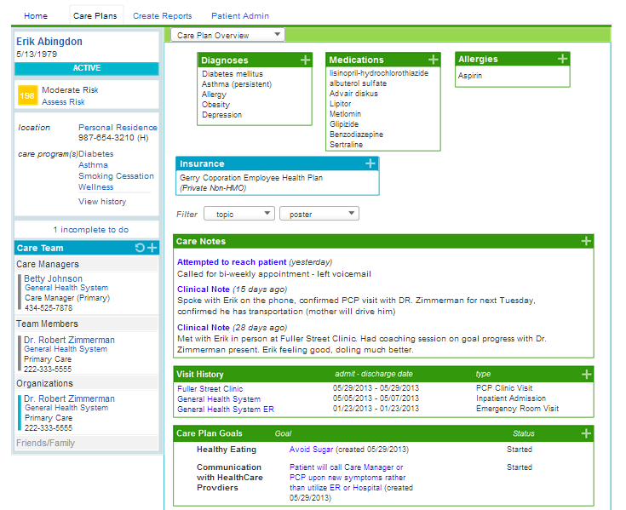
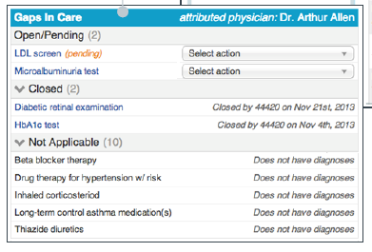
Crimson Care Management
Scalable, Patient-Centered Coordination Across Care Settings
Crimson Care Management App
Risk score updated as diagnoses pulled in from the EMR using FHIR
Patient clinical information (including diagnoses, medications and allergies) automatically fed into EMR using FHIR
Gaps in care presented to caregiver to view, act on, and update on completion
Under Development: Care notes captured during care management encounter sent back to EMR via FHIR
Notes:
x

Slide 11

Questions and Next Steps
Questions?
Contact Information
David Kates
Managing Director, Interoperability
KatesD@advisory.com
(202) 568-7484
Confidential – Not for attribution
Do not duplicate or distribute

